Slide 1
TITLE
Logo
Presented By-
Student Name (ID)
Supervisor: ABC

Slide 2
Logo
Outlines
Research Gaps and Problem Statement
Methodology
References
Publications
Objectives and Contribution
Research Scope and Literature Review

Slide 3
Logo
Problem Statement

Slide 4
Objectives
Logo
List down your objectives (minimum 2 contributions) that is inter-connected with problem statement and measurable in result section.
Be specific to select your objectives and specify your own contributions.

Slide 5
Research Gap
Logo
Defines the boundaries of a study, outlining what will and won’t be covered.
It might be the benchmark that you applied to validate your proposed algorithm.

Slide 6
Literature Review
Logo
List down all the relevant works in order oldest to recent that the audience can understand the current developments and improvements on this domain.
Be specific to compare (results/datasets/parameters/hyper-parameters) them in same environment.

Slide 7
Methodology
Logo
Provide a work-flow diagram of the whole study from start to end (your objectives should be visible here).

Slide 8
References
Sulaiman, M. H., Mustaffa, Z., Saari, M. M., Daniyal, H., Daud, M. R., Razali, S., & Mohamed, A. I. (2018, June). Barnacles mating optimizer: a bio-inspired algorithm for solving optimization problems. In 2018 19th IEEE/ACIS International Conference on Software Engineering, Artificial Intelligence, Networking and Parallel/Distributed Computing (SNPD) (pp. 265-270). IEEE.
Sulaiman, M. H., Mustaffa, Z., Saari, M. M., Daniyal, H., Daud, M. R., Razali, S., & Mohamed, A. I. (2018, June). Barnacles mating optimizer: a bio-inspired algorithm for solving optimization problems. In 2018 19th IEEE/ACIS International Conference on Software Engineering, Artificial Intelligence, Networking and Parallel/Distributed Computing (SNPD) (pp. 265-270). IEEE.

Slide 9
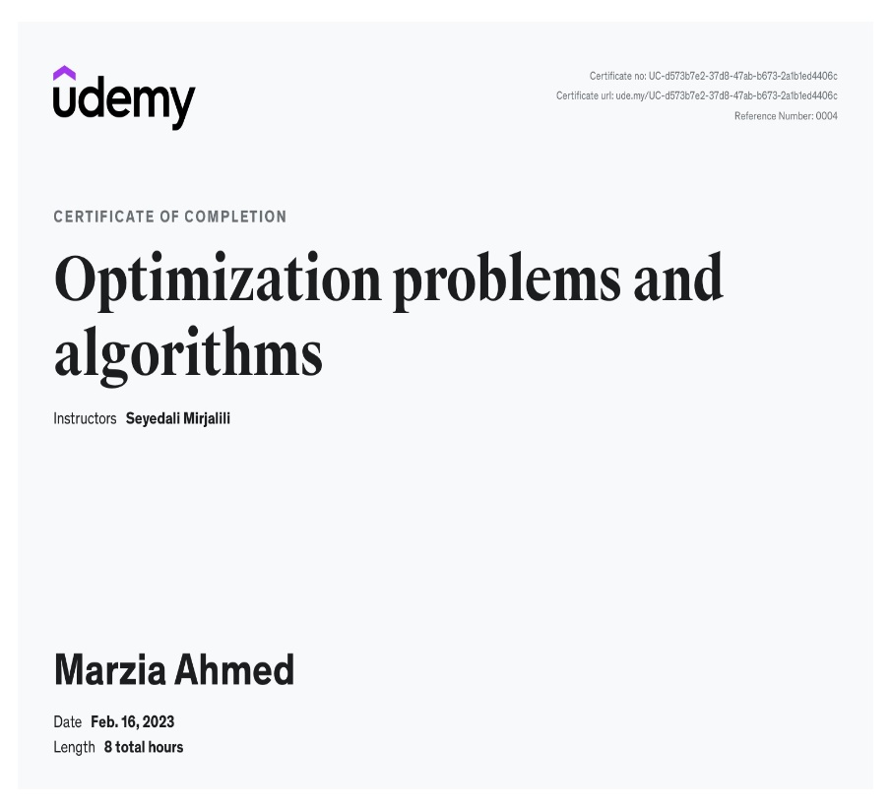

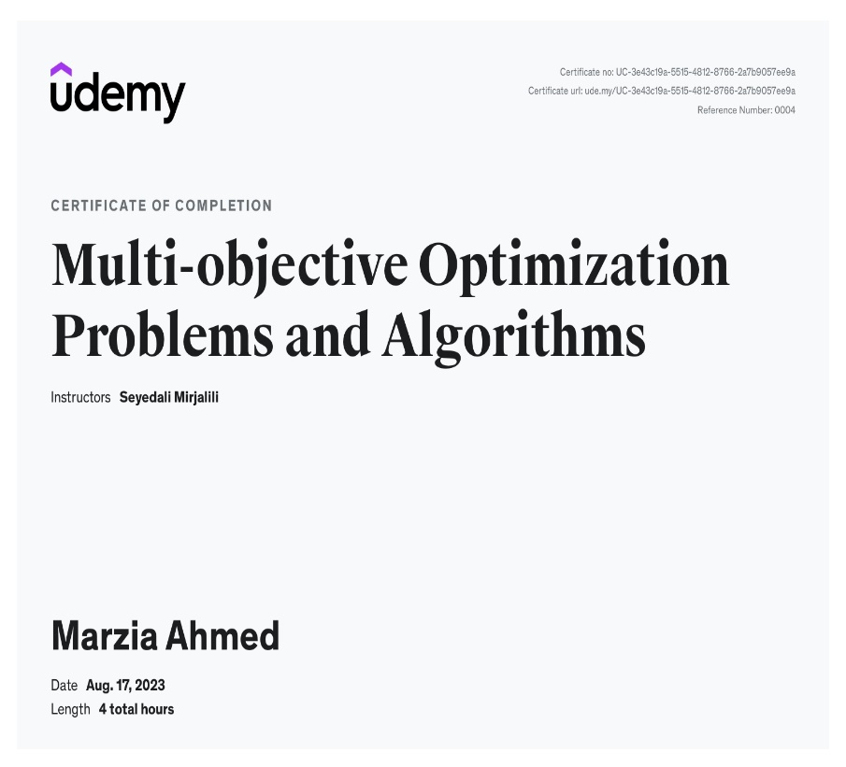
List of Certification

Slide 10
THANK YOU

Slide 11

Question ???

